Slide 1

Transport Layer Part 7
Mark Allman
mallman@case.edu
EECS 325/425
Fall 2018
“Wednesday just don’t go … Thursday goes too slow …”

Slide 2
These slides are more-or-less directly from the slide set developed by Jim Kurose and Keith Ross for their book “Computer Networking: A Top Down Approach, 5th edition”.
The slides have been lightly adapted for Mark Allman’s EECS 325/425 Computer Networks class at Case Western Reserve University.
All material copyright 1996-2010
J.F Kurose and K.W. Ross, All Rights Reserved
Allman

Slide 3

Reading Along ...
3.5: Connection- oriented transport:TCP
reliable data transfer
Allman

Slide 4
Fast Retransmit

Slide 5
Fast Retransmit
time-out period often relatively long:
 long delay before resending lost packet

Slide 6
Fast Retransmit
time-out period often relatively long:
long delay before resending lost packet
detect lost segments via duplicate ACKs.
sender often sends many segments back-to- back
if segment is lost, there will likely be many duplicate ACKs.

Slide 7
Fast Retransmit
time-out period often relatively long:
long delay before resending lost packet
detect lost segments via duplicate ACKs.
sender often sends many segments back-to- back
if segment is lost, there will likely be many duplicate ACKs.
 if sender receives 3 ACKs for the same data, it supposes that segment after ACKed data was lost:
 fast retransmit: resend segment before timer expires
Transport Layer
3-

Slide 8

Host A
Host B
seq=1, len=100
seq=101, len=100 seq=201, len=100
seq=301, len=100 seq=401, len=100
X
ack=101
ack=101 ack=101 ack=101
timeout
seq=101, len=100
resend 2
nd
segment
time
Figure 3.37 Resending a segment after triple duplicate ACK
Transport Layer
3-

Slide 9
Fast retransmit algorithm:
event: ACK received, with ACK field value of y if (y > SendBase) {
SendBase = y
if (there are currently not-yet-acknowledged segments) start timer
}
else {
increment count of dup ACKs received for y if (count of dup ACKs received for y = 3) {
resend segment with sequence number y
}
a duplicate ACK for already ACKed segment
fast retransmit

Slide 10
SR or GBN?

Slide 11
SR or GBN?
Is this selective repeat?

Slide 12
SR or GBN?
Is this selective repeat?
To get something akin to selective repeat we use the Selective Acknowledgment (SACK) option
 Indicates blocks of (begseq,endseq) sequence numbers that have arrived

Slide 13
Host A
Host B
seq=1, len=100
seq=101, len=100 seq=201, len=100
seq=301, len=100 seq=401, len=100
X
ack=101
ack=101, sack 201:300
ack=101, sack 201:400
ack=101, sack 201:500
timeout
seq=101, len=100
resend 2
nd
segment
time
Figure 3.37 Resending a segment after triple duplicate ACK
Transport Layer
3-

Slide 14
SACK
Fundamental change
Cumulative ACK allows us to focus on only a single packet at a time
SACK allows us to concentrate on multiple packets at a time
i.e., the reality of a pipelined system
SACK algorithms get complicated
see RFC 6675 for an example
Transport Layer
3-

Slide 15
Reading Along ...
3.5: Connection- oriented transport:TCP
flow control
Allman
10

Slide 16
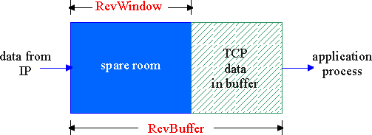
TCP Flow Control
receive side of TCP connection has a receive buffer:

Slide 17
TCP Flow Control
receive side of TCP connection has a receive buffer:
 app process may be slow at reading from buffer

Slide 18
TCP Flow Control
flow control
sender won’t overflow receiver’s buffer by transmitting too much, too fast
 speed-matching service: matching the send rate to the receiving app’s drain rate
receive side of TCP connection has a receive buffer:
 app process may be slow at reading from buffer

Slide 19
TCP Flow control: how it works
rcvr advertises spare room by including value of RcvWindow in segments
sender limits unACKed data to RcvWindow
 guarantees receive buffer doesn’t overflow
(suppose TCP receiver discards out-of-order segments)
spare room in buffer
= RcvWindow
= RcvBuffer-[LastByteRcvd - LastByteRead]

Slide 20
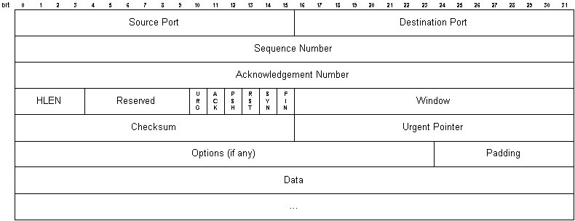
Advertised Window

Slide 21
Advertised Window

Slide 22
Advertised Window
16 bits = 64KB

Slide 23
Advertised Window
16 bits = 64KB
What are the implications of an advertised window limit of 64KB?

Slide 24
Advertised Window
16 bits = 64KB
What are the implications of an advertised window limit of 64KB?
 this is the max we can send at one time

Slide 25
Advertised Window
16 bits = 64KB
What are the implications of an advertised window limit of 64KB?
this is the max we can send at one time
i.e., per RTT

Slide 26
Advertised Window
16 bits = 64KB
What are the implications of an advertised window limit of 64KB?
this is the max we can send at one time
i.e., per RTT
Is 64KB enough?

Slide 27
Advertised Window
16 bits = 64KB
What are the implications of an advertised window limit of 64KB?
this is the max we can send at one time
i.e., per RTT
Is 64KB enough?
No!
This is a place where TCP’s original design has been eclipsed by reality

Slide 28
Advertised Window
ReqAdvWindow = BW x RTT
Or, BW = Window / RTT
We need to be able to fill the so-called “bandwidth-delay product” of a network path to fully utilize the capacity of the path

Slide 29
Advertised Window

Slide 30
Advertised Window
Bandwidth | RTT Delay (sec) | Req. Window | TCP Max Utilization

Slide 31
Advertised Window
Bandwidth | RTT Delay (sec) | Req. Window | TCP Max Utilization
10Mbps | 0.1 | 131 KB | 50%

Slide 32
Advertised Window
Bandwidth | RTT Delay (sec) | Req. Window | TCP Max Utilization
10Mbps | 0.1 | 131 KB | 50%
100Mbps | 0.001 | 13 KB | 100%

Slide 33
Advertised Window
Bandwidth | RTT Delay (sec) | Req. Window | TCP Max Utilization
10Mbps | 0.1 | 131 KB | 50%
100Mbps | 0.001 | 13 KB | 100%
1Gbps | 0.0001 | 13 KB | 100%

Slide 34
Advertised Window
Bandwidth | RTT Delay (sec) | Req. Window | TCP Max Utilization
10Mbps | 0.1 | 131 KB | 50%
100Mbps | 0.001 | 13 KB | 100%
1Gbps | 0.0001 | 13 KB | 100%
1Gbps | 0.002 | 268 KB | 24%

Slide 35
Advertised Window
Bandwidth | RTT Delay (sec) | Req. Window | TCP Max Utilization
10Mbps | 0.1 | 131 KB | 50%
100Mbps | 0.001 | 13 KB | 100%
1Gbps | 0.0001 | 13 KB | 100%
1Gbps | 0.002 | 268 KB | 24%
622Mbps | 0.5 | 41 MB | 0.2%

Slide 36
Advertised Window
Bandwidth | RTT Delay (sec) | Req. Window | TCP Max Utilization
10Mbps | 0.1 | 131 KB | 50%
100Mbps | 0.001 | 13 KB | 100%
1Gbps | 0.0001 | 13 KB | 100%
1Gbps | 0.002 | 268 KB | 24%
622Mbps | 0.5 | 41 MB | 0.2%
Many common scenarios—and some uncommon ones!—require windows TCP cannot encode.

Slide 37
Window Scaling

Slide 38
Window Scaling
Window Scaling introduced (RFC 1323)

Slide 39
Window Scaling
Window Scaling introduced (RFC 1323)
TCP option included in the SYN that offers a “window scale” …. i.e.,

Slide 40
Window Scaling
Window Scaling introduced (RFC 1323)
TCP option included in the SYN that offers a “window scale” …. i.e.,
 the number of bits a sender will shift the true window right before sending

Slide 41
Window Scaling
Window Scaling introduced (RFC 1323)
TCP option included in the SYN that offers a “window scale” …. i.e.,
The number of bits a sender will shift the true window right before sending
The number of bits a receiver must shift the received window to the left before using

Slide 42
Window Scaling
Window Scaling introduced (RFC 1323)
TCP option included in the SYN that offers a “window scale” …. i.e.,
The number of bits a sender will shift the true window right before sending
The number of bits a receiver must shift the received window to the left before using
Must be agreed to in the SYNACK

Slide 43
Window Scaling

Slide 44
Window Scaling
Example with scale factor of 2

Slide 45
Window Scaling
Example with scale factor of 2
Sender:
 true_window = 140 KB = 143,360 bytes = 10 00110000 00000000

Slide 46
Window Scaling
Example with scale factor of 2
Sender:
true_window = 140 KB = 143,360 bytes = 10 00110000 00000000
advwin = true_window >> 2
= 10001100 00000000 = 35840

Slide 47
Window Scaling
Example with scale factor of 2
Sender:
true_window = 140 KB = 143,360 bytes = 10 00110000 00000000
advwin = true_window >> 2
= 10001100 00000000 = 35840
Receiver:
 received_win = 10001100 00000000 = 35840

Slide 48
Window Scaling
Example with scale factor of 2
Sender:
true_window = 140 KB = 143,360 bytes = 10 00110000 00000000
advwin = true_window >> 2
= 10001100 00000000 = 35840
Receiver:
 received_win = 10001100 00000000 = 35840
true_window = received_win << 2
= 10 00110000 00000000 = 140 KB

Slide 49
Window Scaling

Slide 50
Window Scaling
Can shift by up to 14 bits
I.e., windows can now grow to 2^30 or 1GB

Slide 51
Window Scaling
Can shift by up to 14 bits
I.e., windows can now grow to 2^30 or 1GB
Accommodates most (all?) current network paths
 some are currently pushing to support use of 15 bits of scaling and hence windows with 2^31 or 2GB

